Slide 1
ONLINE SECURE PAYMENT USING FACE RECOGNITION
SARATH KUMAR S (921317104192)
SANTHOSH LUITEL (921317104191)
SANTHOSH S (921317104187)
SANTHOSH S (921317104186)

Slide 2
ABSTRACT
Online Secure Payment using Face Recognition is a web based application which enables a more secure online money transaction.
The advancements in technology have led to a surge in online transactions via online shopping, internet banking, payment gateways, etc.
In the current world of advanced technology, it is easy for hackers to get personal details of users because of which some people are hesitant to use online transactions. This makes security an important factor at the time of making digital payments.
For this reason, to make transaction more secure we use face recognition instead of OTP or MPIN.
Facial recognition has improved dramatically in recent years and the best face identification algorithm has an error of just 0.08% making it more reliable and secure than OTP.

Slide 3
MERITS OF THE PROBLEM
The purpose of our project is to develop a web-based application which is used for online payment in a more secure way.
To make transaction more secure we use face recognition instead of OTP or MPIN.
With face recognition, there are no passwords that hackers could compromise. Even if hackers stole your photo database, it would be of little use, as “liveness detection,” prevent using them for impersonation purposes.

Slide 4
HARDWARE REQUIREMENTS
Any Operating System
System with in-built/external Camera
SOFTWARE REQUIREMENTS
Python
Django

Slide 5
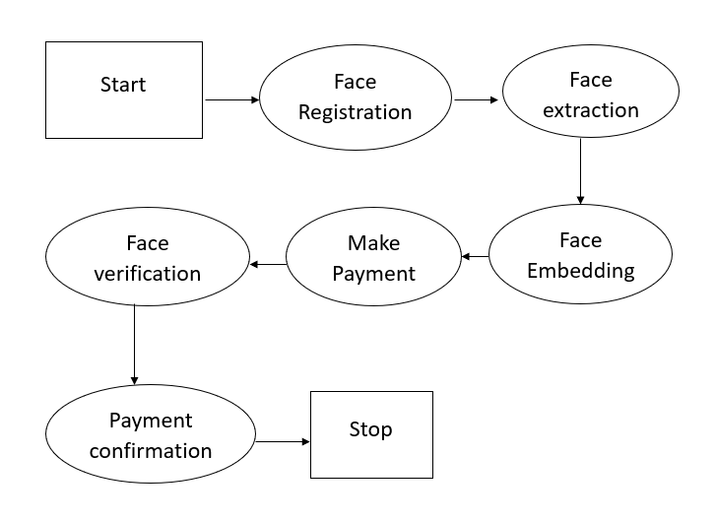
HIGH LEVEL DESIGN

Slide 6
LOW LEVEL DESIGN
USE CASE DIAGRAM:
Use Case Diagram captures the system’s functionality and requirements by using actors and use cases
SEQUENCE DIAGRAM:
Sequence Diagram is an interaction diagram that details how operations are carried out-what messages are sent and when.

Slide 7
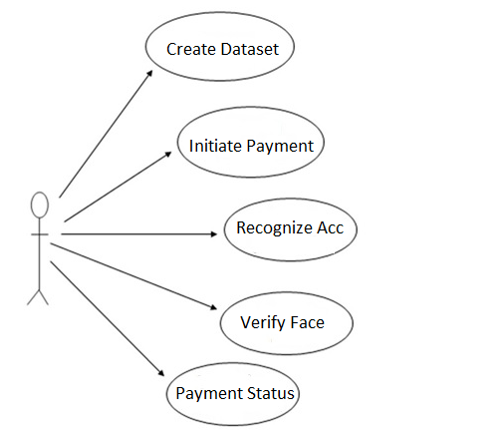
USE CASE DIAGRAM

Slide 8
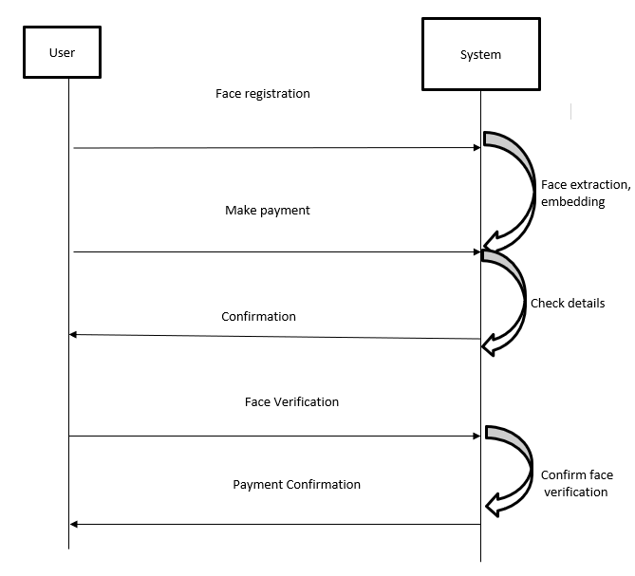
SEQUENCE DIAGRAM

Slide 9
MODULES
Face Enrolment
Payment

Slide 10
THANK YOU

